Slide 1
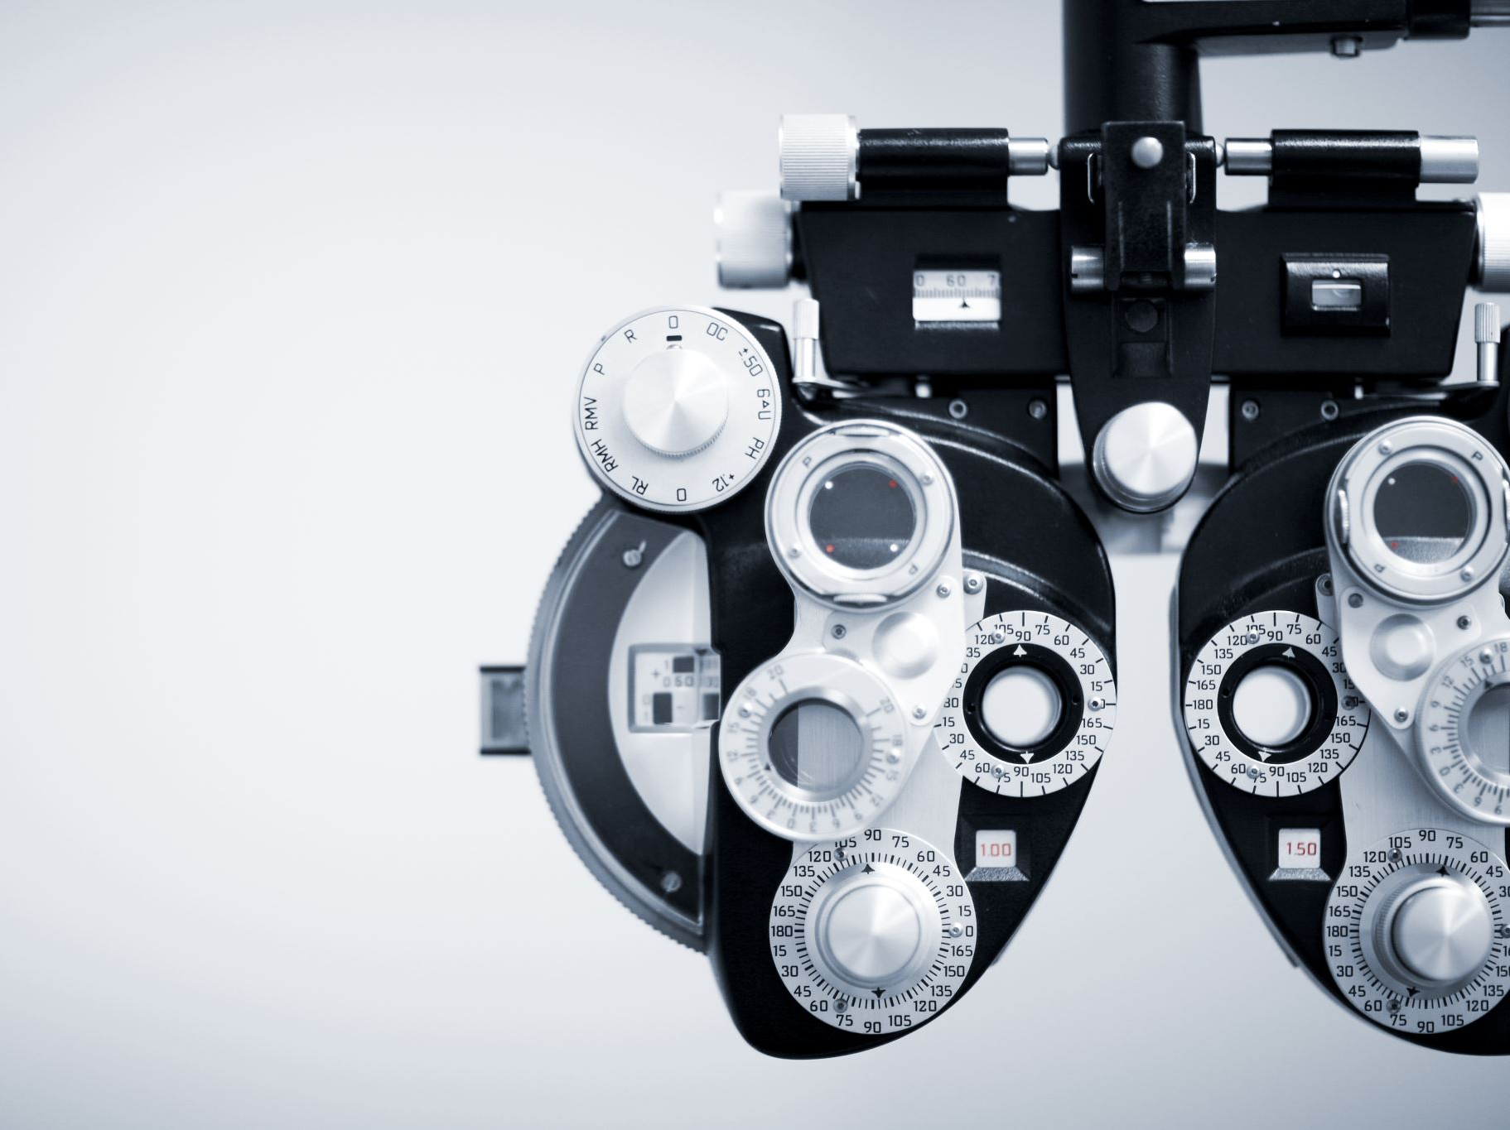
Metagenics CRM Transformation
From Sales Tracking to AI-Assisted Selling Platform

Slide 2

Metagenics Sales Context
Field-based sales reps engaging healthcare practitioners
Focus on product education, training, and relationship building
Revenue driven by repeat orders and product adoption
Multi-channel engagement: in-person, virtual, eCommerce

Slide 3
Metagenics Today
Current State
Key Challenges
Reps manually prepare for visits with limited insights
Sales data exists but is not easily actionable
Engagements are logged but not standardized
Follow-ups depend on rep memory
Limited visibility into product adoption opportunitie
Missed cross-sell / upsell opportunities
Inconsistent rep performance
Low visibility into account health
Reactive sales approach
CRM seen as reporting tool, not selling tool

Slide 4
Future State Vision
AI-assisted selling embedded in Dynamics 365
Reps guided at every stage (Prep → Engage → Close)
Automated insights from sales + eCommerce data
Standardized engagement and follow-up process
CRM becomes a daily sales assistant

Slide 5

Prep Call Transformation
AI-generated account summaries before visits
Highlight top products and gaps in ordering
Identify inactive or at-risk accounts
Recommend talking points and product focus
Route optimization for field reps

Slide 6

Engagement Transformation
Structured capture of visits, calls, and trainings
AI suggests products based on discussion
Guided selling prompts during engagement
Automatic next-step recommendations
Standardized engagement types (training, maintenance, growth)

Slide 7

Closing Transformation
AI identifies best products to recommend
Automated follow-ups created instantly
Order triggers and eCommerce alignment
Deal risk detection and alerts
Issue tracking and resolution workflows

Slide 8
Business Impact
Increase product adoption across accounts
Improve rep productivity in the field
Reduce missed follow-ups
Increase average order value
Drive predictable revenue growth

Slide 9
Implementation Roadmap
Phase 1: Foundation (1–5 weeks)
Clean data
Phase 2: Visibility (Weeks 6–9)
Dashboards
Phase 3: Automation (Weeks 10–14)
Introduce AI insights Automation
Phase 4: AI Weeks (15–20)
Advanced predictive selling AI summaries
Define process
Required fields
Quick wins
User adoption
Auto follow-ups
Alerts
Process flows
Next best action
Risk alerts

Slide 10
